Slide 1

App Service Management Tools
[speaker]

Slide 2
Portal

Slide 3
Two Tips
Portal feature comparison
Internal portal

Slide 4
https://azure.microsoft.com/en-us/features/azure-portal/availability/

Slide 5
Internal portal
http://aka.ms/publicportal

Slide 6
Continuous Deployment with Git

Slide 7
CLI

Slide 8
CLI 2.0 (Preview)

Slide 10
Announcing Azure Command-Line Interface (CLI) 2.0 Preview
A new native Posix/BASH based Commandline experience
Available at GitHub in preview mode – looking for early feedback and engagement with adopters
Current xplat CLI will continue to be available and supported – will be needed for ASM services
Both CLIs work side-by-side in the same command shell window

Slide 11
Goals for the new release
Natural and easy to install
Native install scripts for every platform (Brew, apt-get, PIP, yum, MSI)
Consistent and works nicely with POSIX tools
Integrates well with GREP, AWK, JQ and all other common tools and commands
Productivity features for command completion, parameter values, help
Optimized for standalone commands, automation scripts
Part of Open Source ecosystem
Open sourced; Open to contributions (governance policy coming)
Ever-fresh with Azure
Consistent and complete coverage of all Azure services
Supports side-by-side install and usage with current xplat CLI (will continue to be available and supported)
Try it out – we want your feedback!

Slide 12
[optional]
ARM Template
Swagger
AutoRest
SDKs
CLI
"parameters": {
"size": {
"type": "string",
"defaultValue": "Standard_A2",
...
"VMParameters": {
"properties": {
"size": {
"type": "object",
"$ref": "#/definitions/DeploymentParameter_size",
"description": "The VM Size that should be created.",
"x-ms-client-flatten": true
VirtualMachine vm = subscription.virtualMachines().define("myVM")
.withRegion(Region.US_WEST)
.withNewResourceGroup("myresourcegroup")
.withNewNetwork("myVNnet", "10.0.0.0/28")
.withPrivateIpAddressDynamic()
.withNewPublicIpAddress()
.withLatestImage("MicrosoftWindowsServer", "WindowsServer", "2008-R2-SP1")
.withSize(Size.Type.Standard_A2)
.withNewStorageAccount()
.withNewDataDisk(100)
.provision();
$ az vm create
Usage az vm create <resource-group> <image> [size]
Options:
-h, --help Output usage and help information
--name <name> The virtual machine name
--size <instance-size> The VM Size that should be created.
--sshkey The SSH key
Full Swagger Spec
Example ARM Template
CLI Command Generator
Notes:
CLI 2.0 and the new Fluent SDK are actually built from the Swagger specs for the Azure service endpoints. It's a full end-to-end automated pipeline, so when a service is added or updated, everything's up to date and in-sync: CLI (both commands and help), SDK, docs.

Slide 13
Installation Walkthrough: Bash on Windows
https://aka.ms/getprojectaz
Native install scripts for every platform (Brew, apt-get, PIP, yum, MSI)
sudo apt-get update
sudo apt-get install -y libssl-dev libffi-dev
sudo apt-get install -y python-dev curl -L https://aka.ms/InstallAzureCli | sudo bash
exec -l $SHELL

Slide 14
Demo
Azure Command-Line Interface (CLI) 2.0 Preview

Slide 15
Notes:
This is a backup slide to quickly demo CLI 2.0 features

Slide 16
App Service Companion

Slide 17
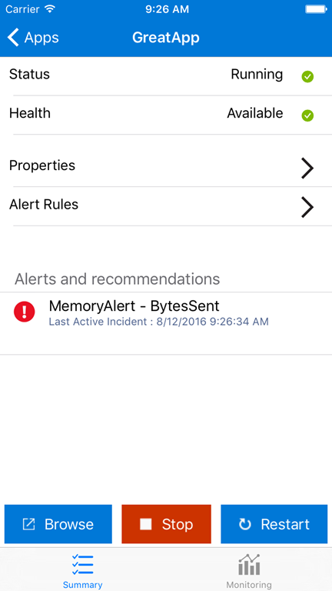
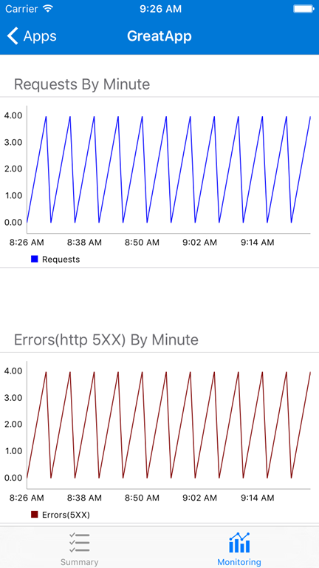
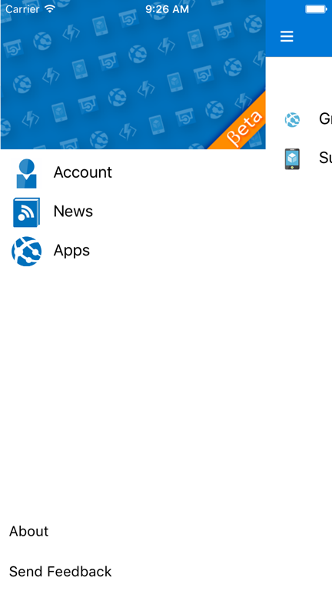
App Service Companion

Slide 18
App Service Companion
Android and iOS, US only currently
Xamarin app
Hockey app
Mobile app backend

Slide 19
Visual Studio

Slide 20

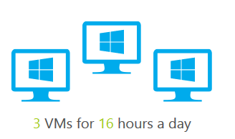

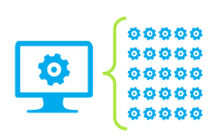
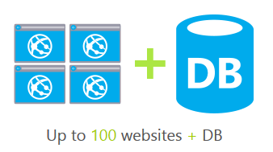
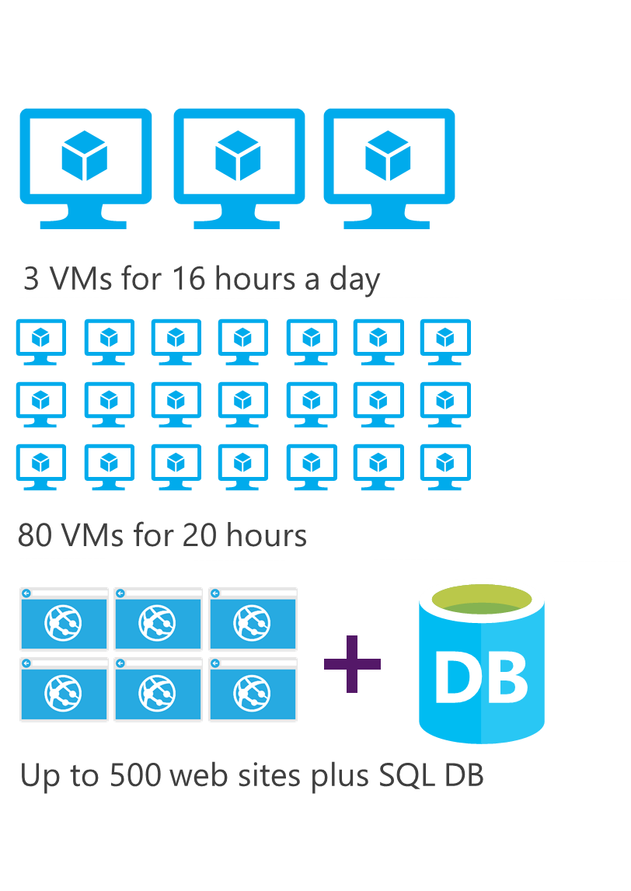
DEV ESSENTIALS
Microsoft Azure benefits
$25/month
Visual Studio Dev Essentials (free)
Not a Visual Studio subscriber? Get a $25 monthly Azure credit by joining Visual Studio Dev Essentials
3 VMs for 8 hours a day
40 VMs for 20 hour load test
25 HDInsight nodes for 10 hours
Up to 50 websites + DB
Visual Studio subscription (paid, MPN, or BizSpark)
Try out different Azure services, experiment, and learn
Provision developer machines with Visual Studio VMs in Azure
Great for individual dev/test workloads
Each Visual Studio subscriber gets up to $150 per month to use for dev/test in Azure
No charge for software installed for dev and test, plus access to subscriber-only VM gallery and special dev/test rates on HDInsight, Web Apps, and Cloud Service instances
PROFESSIONAL/TEST PROFESSIONAL
$50/month
MSDN PLATFORMS
$100/month
ENTERPRISE
$150/month

